Slide 1
Scientists and Their Discoveries
By: Carson Lester
P.5 EHAP 2012-2013

Slide 2
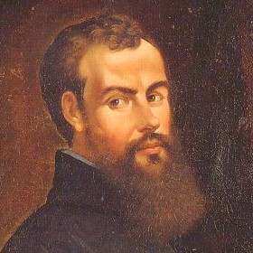
Andreas Vesalius
He was born on December 31st, 1514 in Brussels ,Belgium. He hailed from a family of physicians and studied in Paris as well as the University of Louvain.
He believed that surgery was a vital branch of medicine. He performed dissections by himself and produced detailed charts of the cardiovascular and nervous systems.

Slide 3
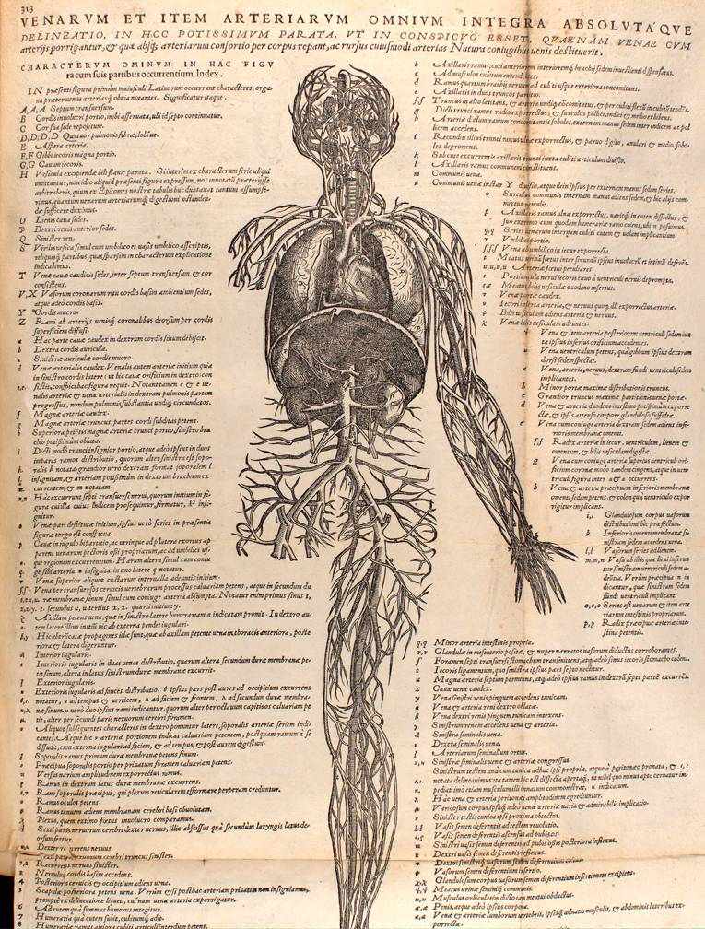
He wrote a pamphlet on bloodletting, a popular medical treatment for disease. He argued that ,with his knowledge of the human body from dissection , he could pinpoint the areas which would provide the most benefit.
He later got dissection materials from a judge interested in his work.
His acclaimed book “De Humani Corporis Fabrica”
(The Structure of the Human Body) was about the styles and procedures of dissection
De Humani Corporis Fabrica
He passed away in 1564 on a journey home.

Slide 4
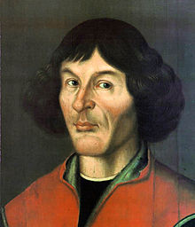
Nicolaus Copernicus
Copernicus was born in Thorn, Poland on February 19, 1473. He was born to a wealthy merchant family. He was raised my his uncle and was appointed as a canon of the Catholic church. He used the income from his position for additional studies at the University of Krakow.
He studied law and medicine at three different Italian universities. His interest in astronomy was brought about while studying at the University of Bologna.

Slide 5
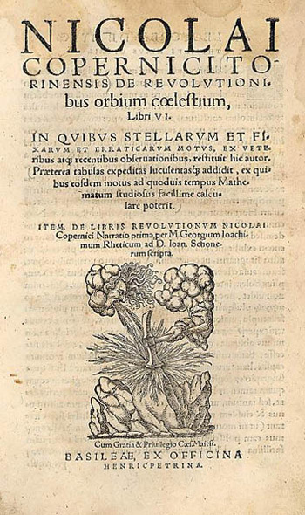
He developed the heliocentric model of the universe, following his skepticism of Ptolemy’s geocentric model (geocentric meaning Earth is in the middle of the universe). His argument was that the sun ought to be at the center, since it is the most splendid of celestial bodies.
His theory of Heliocentricity was first brought up in his book “On the Revolutions of the Heavenly Spheres”
(De Revolutionibus orbium).
He passed away on May 24th, 1543.

Slide 6
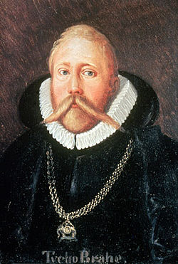
Dane Tycho Brahe
He was born in 1546 to a devout protestant family. He built an observatory on the land that King Frederick II of Denmark granted him.
Before the invention of the telescope, he tracked the paths of the moon and planets over decades, producing the most remarkable observations. But his theories were a close mix of Ptolemy and Copernicus.

Slide 7
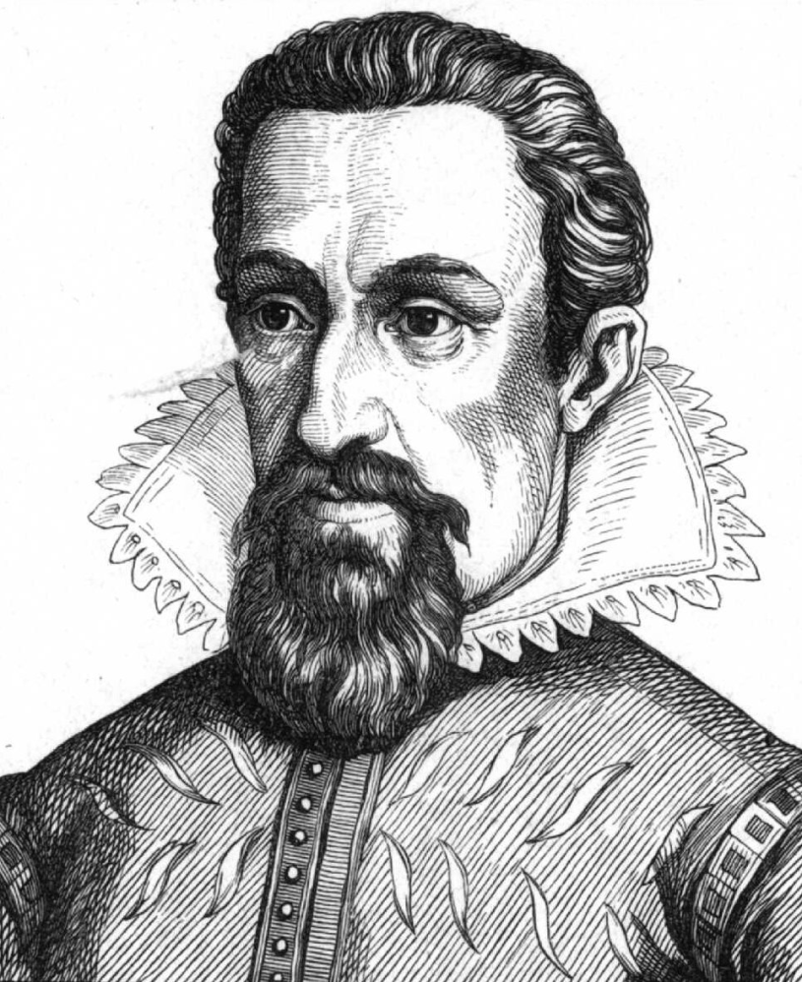
Johannes Kepler
Born in 1571, Kepler was one of Tycho Brahe’s assistants. Brahe mistrusted him and gave him the difficult Martian job, to which Kepler was able to form the correct laws of planetary motion.
He proved that the planet’s orbits are in fact ellipses. His three laws of planetary motion were so revolutionary, that it was not until Isaac Newton that people began to accept them.

Slide 8
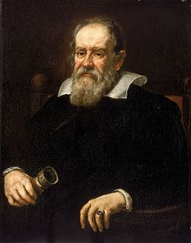
Galileo Galilei
Born in 1564, he was the first to connect the motion of the planets with the motion of our own planet. He began to work with telescopes while studying at the University of Padua.
He was the first person to come up with the concept of inertia. He said that all heavenly bodies were naturally at rest and needed to be pushed constantly to keep moving.

Slide 9
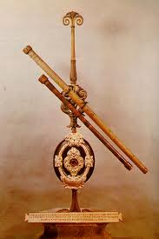
He gained an insight into physics while watching people at the Arsenal in Venice use pulleys. He invented a primitive form of the telescope that he built out of a Dutch lens maker’s invention.
He became a member of one of the first scientific societies, the Academia dei Lincei. He was the first person to view the mountains on the moon, to which he compared them to the ones in Bohemia.

Slide 10
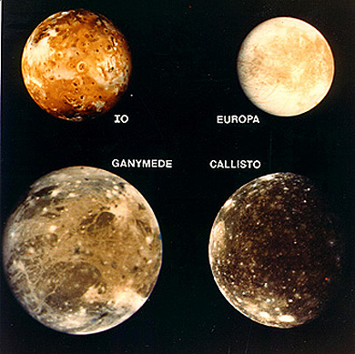
One of his greatest achievements, to which we still name them after him, is Galileo’s discovery of the moons of Jupiter. When he first viewed them, he called them the Medicean Stars
(after the Medici's ). He also called them planets, and commented on how if we only have a moon circling us and Jupiter has four planets, then we aren’t unique.
He published many scientific pamphlets such as the “Letters on Sunspots” (1612) and “The Assayer” which talked about comets being a celestial phenomenon.
He passed away January 8th, 1642

Slide 11
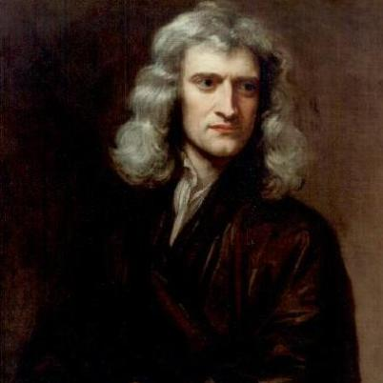
Isaac Newton
Born on January 4th, 1642 Isaac Newton became one of the most brilliant minds of the 17th and 18th centuries. When he was eighteen he went to Cambridge university to study math, physics, and astronomy.
During this time he began to think about gravity as well as fluxions (calculus). In 1669 he became a mathematics professor and his refracting telescope he built brought him closer to science.

Slide 12
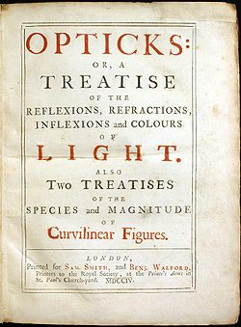
He conducted experiments on the composition of light. He discovered white light is composed of all other colors. He published a paper on it called the “Opticks” about light and color.
In 1687, he published “ The Mathematical Principles of Natural Philosophy” or “The Principia”. This was where his concept of gravity first came into pay.

Slide 13
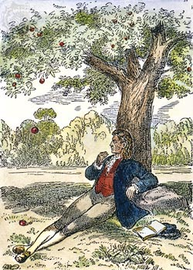
When Newton first published The Principia, he talked about gravity as a universal force that acts upon all celestial bodies. By this discovery he was able to form his three laws of motion
Law #1: In the absence of force, motion continues in a straight line
Law #2: the rate of change of motion is determined by the forces acting upon it.
Law #3: action and reaction between two bodies are equal and opposite.
Newton's Apple Story- Click Here

Slide 14
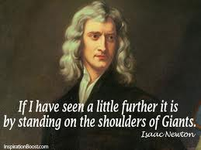
Though people criticized him, his discoveries became the largest discoveries of the 17th century. Robert Hooke, his long time rival, said that he only came upon his conclusions through the works of others.
He mockingly said that Newton stood on the shoulder of giants. To which, Newton replied by saying that even from the shoulder of giants he could see furthest than any other before him.
He passed away March 20th, 1727

Slide 15
Work cited
http://csep10.phys.utk.edu/astr161/lect/history/kepler.html
http://plato.stanford.edu/entries/galileo/
https://encrypted-tbn2.gstatic.com/images?q=tbn:ANd9GcTYLiDNSIA1EsrJQlVA8m-CNeCTBKb7aFH0C9SbiGDYzUXniKfd
http://www2.astro.psu.edu/users/niel/astro1/slideshows/class41/010-jupiter-galilean-moons.jpg
http://www.bbc.co.uk/history/historic_figures/newton_isaac.shtml
http://www.biography.com/people/isaac-newton-9422656?page=2
http://www.biography.com/imported/images/Biography/Images/Profiles/N/Sir-Isaac-Newton-9422656-1-402.jpg
http://upload.wikimedia.org/wikipedia/commons/thumb/a/a0/Opticks.jpg/250px-Opticks.jpg
http://www.uh.edu/engines/epi606.htm
http://www.xtimeline.com/__UserPic_Large/1216/ELT200708122309454250611.JPG
http://www.phrases.org.uk/meanings/268025.html
https://encrypted-tbn3.gstatic.com/images?q=tbn:ANd9GcQ2v9oY29tvlKB5pqMpIq-Qq_qXvkdgVfrObAzKQO-RhtbN4D-2
http://www.bbc.co.uk/history/historic_figures/vesalius_andreas.shtml
http://plato.stanford.edu/entries/galileo/
http://ircamera.as.arizona.edu/NatSci102/NatSci102/lectures/tycho.htm

Slide 16
Work Cited (cont..)
http://www.reformation.org/tycho-brahe.html
http://upload.wikimedia.org/wikipedia/commons/thumb/2/2b/Tycho_Brahe.JPG/250px-Tycho_Brahe.JPG
http://upload.wikimedia.org/wikipedia/commons/thumb/d/d4/Justus_Sustermans_-_Portrait_of_Galileo_Galilei,_1636.jpg/220px-Justus_Sustermans_-_Portrait_of_Galileo_Galilei,_1636.jpg
http://remnanttrust.ipfw.edu/assets/images/docs/science-technology/de-revolutionibus/de-revolutionibus.jpg
http://myloc.gov/Exhibitions/EarlyAmericas/AftermathoftheEncounter/DocumentingNewKnowledge/MappingtheWorld/ExhibitObjects/OntheRevolutionsoftheHeavenlySpheres.aspx
http://muse.tau.ac.il/museum/galileo/heliocentric.html
http://wpcontent.answcdn.com/wikipedia/commons/thumb/f/f2/Nikolaus_Kopernikus.jpg/220px-Nikolaus_Kopernikus.jpg
http://quod.lib.umich.edu/w/wantz/images/vesdp02.jpg
http://starchild.gsfc.nasa.gov/docs/StarChild/whos_who_level2/copernicus.html
http://www.history.com/news/a-brief-history-of-bloodletting

